Slide 1
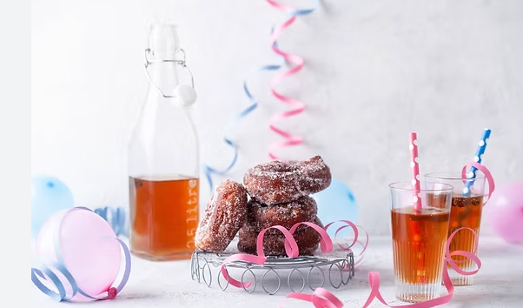
Ladonlukon Vappusima 1,5l
May Day Mead
6,00 €

